Slide 1



Slide 2

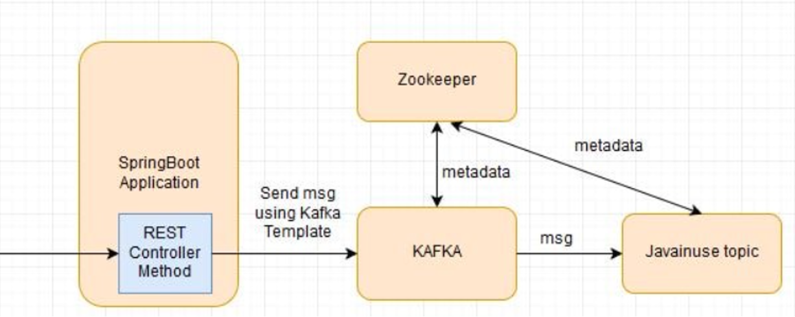
Spring Boot with Kafka

Slide 3
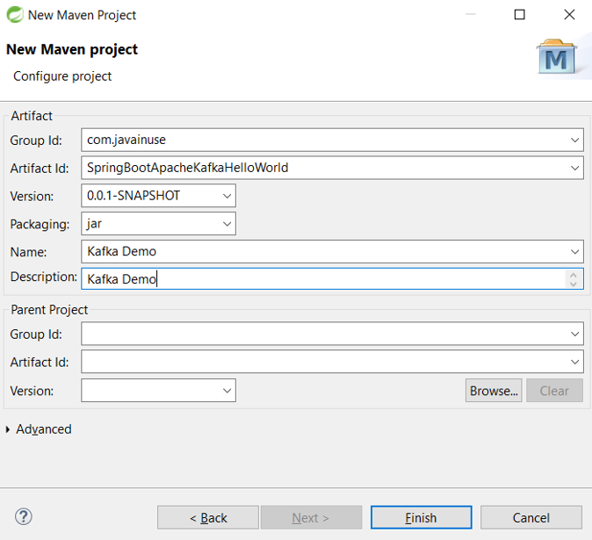
Spring Boot with Kafka
Creating a Maven Project

Slide 4
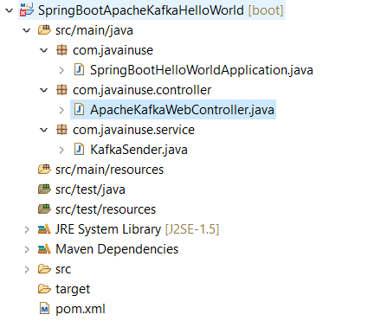
Spring Boot with Kafka
Project Structure

Slide 5
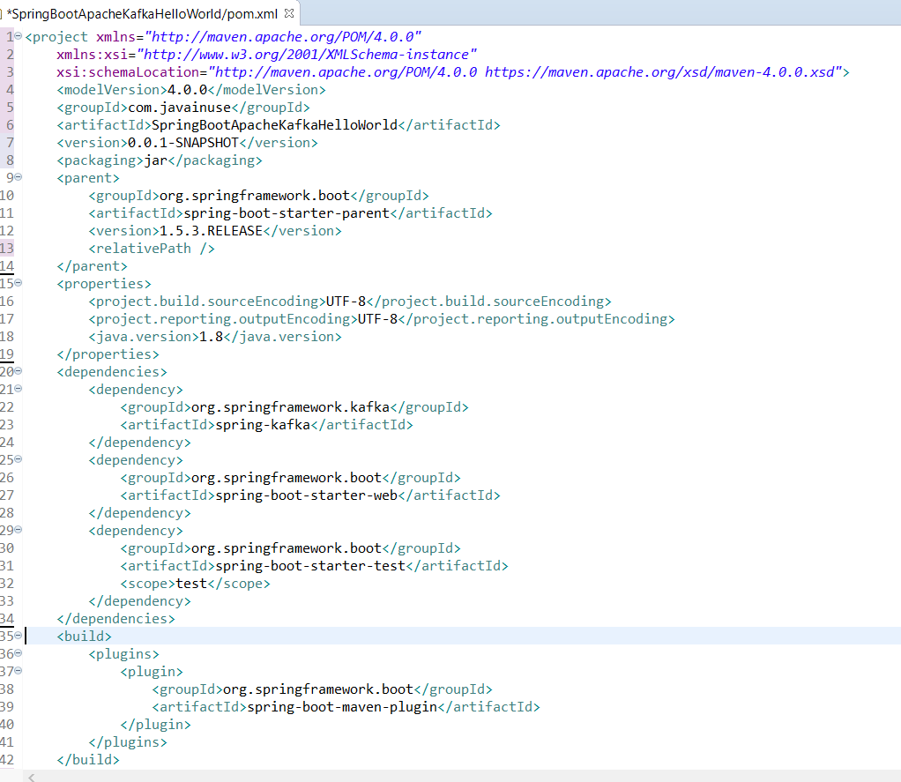
Spring Boot with Kafka
Pom.xml

Slide 6
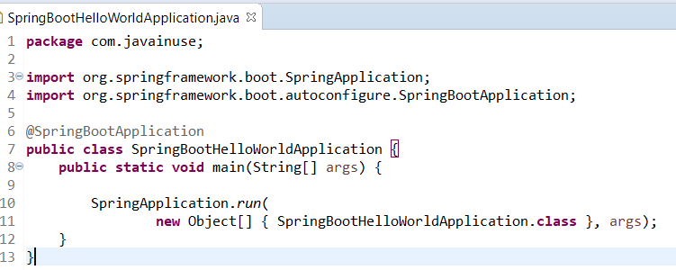
Spring Boot with Kafka
Main Program

Slide 7
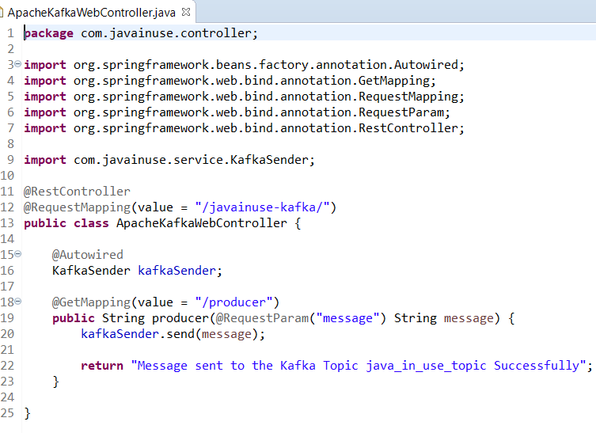
Spring Boot with Kafka
RestController

Slide 8
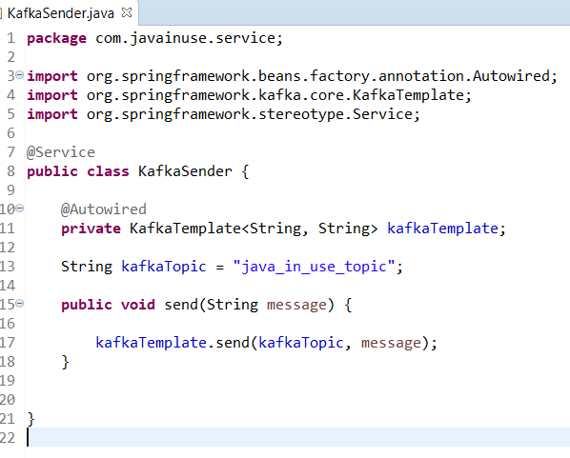
Spring Boot with Kafka
Creating a Service

Slide 9
Spring Boot with Kafka
Starting Zookeeper, Kafka Server and Spring Boot Application
Start Apache Zookeeper
.\bin\windows\zookeeper-server-start.bat .\config\zookeeper.properties
Start Apache Kafka
.\bin\windows\kafka-server-start.bat .\config\server.properties
Start the Spring Boot Application

Slide 10
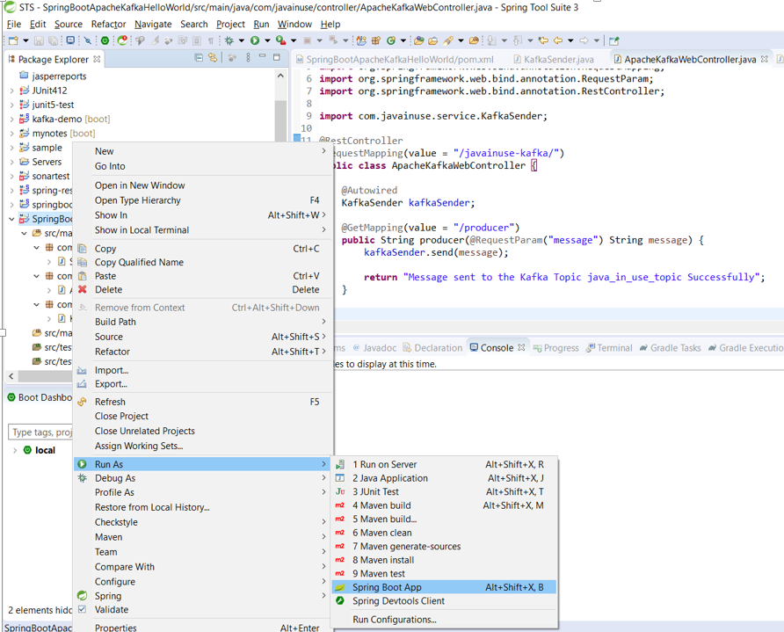
Spring Boot with Kafka
Running Project as Spring Boot App

Slide 11
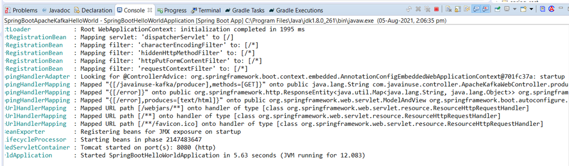
Spring Boot with Kafka
Spring Boot Application Started

Slide 12
Spring Boot with Kafka
Start the Consumer
Start the consumer listening to the java_in_use_topic
.\bin\windows\kafka-console-consumer.bat --bootstrap-server localhost:9092 --topic java_in_use_topic --from-beginning
Finally hit the url as follows- http://localhost:8080//javainuse-kafka/producer?message=test
localhost:8080//javainuse-kafka/producer?message=test

Slide 13
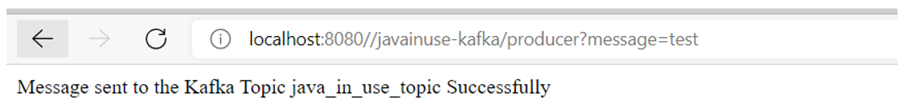
Spring Boot with Kafka
Invoke the URL
This will trigger the message to be sent to the java_in_use_topic. We can see in the consumer started receiving the message “test”.

Slide 14
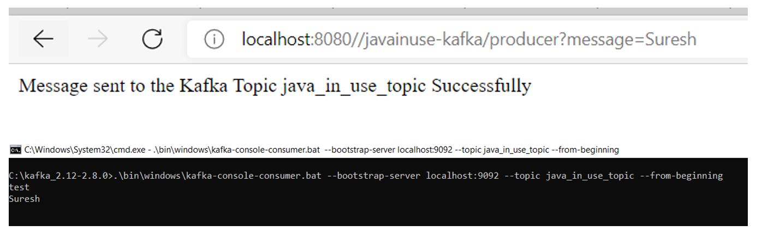
Spring Boot with Kafka
Invoke the URL

